Slide 1


NODE.JS GLOBAL
DEPLOY AND TOOLS
MARCH, 2019

Slide 2
AGENDA
Development tools
Install and deploy
Demonizing the application
Logging

Slide 3
DEVELOPMENT TOOLS. ESLINT
De-facto standart
Checking possible code errors
Fixing code style
Detect code anti-patterns
Rules are pluggable
Supports typescript also
Integration with IDE
https://eslint.org/
Notes:
ESLint is the de-facto standard for checking possible code errors and fixing code style, not only to identify nitty-gritty spacing issues but also to detect serious code anti-patterns like developers throwing errors without classification.
On top of ESLint standard rules that cover vanilla JavaScript, add Node.js specific plugins like eslint-plugin-node
https://www.robertcooper.me/using-eslint-and-prettier-in-a-typescript-project
When it comes to linting TypeScript code, there are two major linting options to choose from: TSLint and ESLint. TSLint is a linter than can only be used for TypeScript, while ESLint supports both JavaScript and TypeScript.
In the TypeScript 2019 Roadmap, the TypeScript core team explains that ESLint has a more performant architecture than TSLint and that they will only be focusing on ESLint when providing editor linting integration for TypeScript. For that reason, I would recommend using ESLint for linting TypeScript projects.

Slide 4
DEVELOPMENT TOOLS. ESLINT. Config
module.exports = {
parser: '@typescript-eslint/parser', // Specifies the ESLint parser
extends: [
'plugin:@typescript-eslint/recommended', // Uses the recommended rules from the @typescript-eslint/eslint-plugin
],
parserOptions: {
ecmaVersion: 2018, // Allows for the parsing of modern ECMAScript features
sourceType: 'module', // Allows for the use of imports
},
rules: {
// Place to specify ESLint rules. Can be used to overwrite rules specified from the extended configs
// e.g. "@typescript-eslint/explicit-function-return-type": "off",
},
};
https://eslint.org/

Slide 5
DEVELOPMENT TOOLS. PRETTIER
Code formatter
Working with ESLint
https://prettier.io/

Slide 6
DEVELOPMENT TOOLS. PRETTIER
module.exports = {
semi: true,
trailingComma: 'all',
singleQuote: true,
printWidth: 120,
tabWidth: 4,
};
https://prettier.io/

Slide 7
DEVELOPMENT TOOLS. PRETTIER
module.exports = {
parser: '@typescript-eslint/parser', // Specifies the ESLint parser
extends: [
'plugin:@typescript-eslint/recommended', // Uses the recommended rules from the @typescript-eslint/eslint-plugin
'prettier/@typescript-eslint', // Uses eslint-config-prettier to disable ESLint rules from @typescript-eslint/eslint-plugin that would conflict with prettier
'plugin:prettier/recommended', // Enables eslint-plugin-prettier and displays prettier errors as ESLint errors. Make sure this is always the last configuration in the extends array.
],
parserOptions: {
ecmaVersion: 2018, // Allows for the parsing of modern ECMAScript features
sourceType: 'module', // Allows for the use of imports
},
};
https://prettier.io/

Slide 8
DEVELOPMENT TOOLS. NODEMON
Automatically restarting the node application
Doesn’t require any additional changes to your code
https://nodemon.io/

Slide 9
DEVELOPMENT TOOLS. NODEMON
// nodemon.json
{
"verbose": true,
"ignore": ["*.test.js", “fixtures/*"],
….
}
https://nodemon.io/

Slide 10
DEVELOPMENT TOOLS. POSTMAN
Composing HTTP requests (headers, auth, data)
Automated testing with collections of requests
Mock specific server data
History logging
API monitoring
https://www.getpostman.com

Slide 11
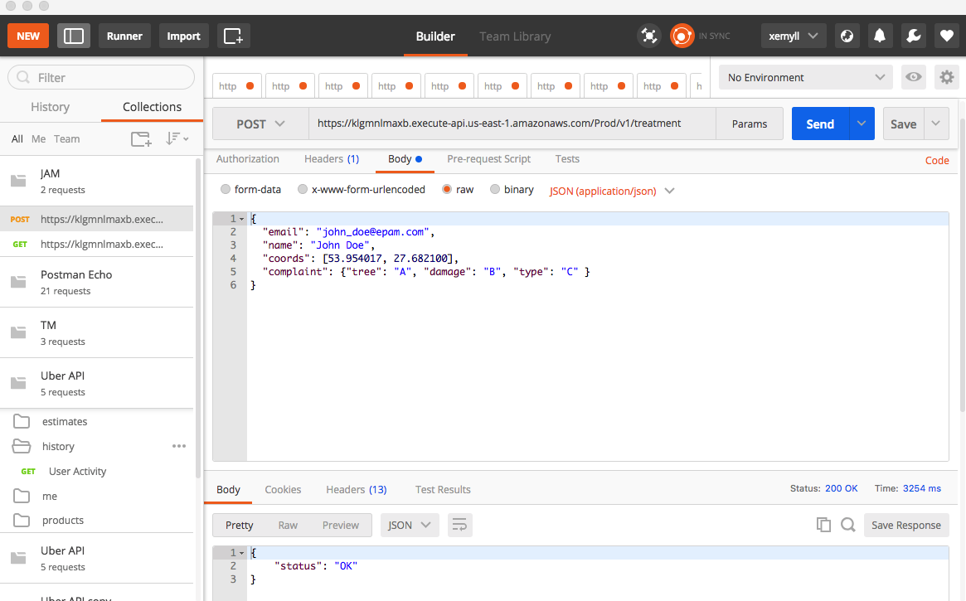
DEVELOPMENT TOOLS. POSTMAN
https://www.getpostman.com

Slide 12
DEVELOPMENT TOOLS. GRAPHIQL
Syntax highlighting
Intelligent type ahead
Real-time error highlighting and reporting
Automatic query completion
Run and inspect query results
https://electronjs.org/apps/graphiql

Slide 13
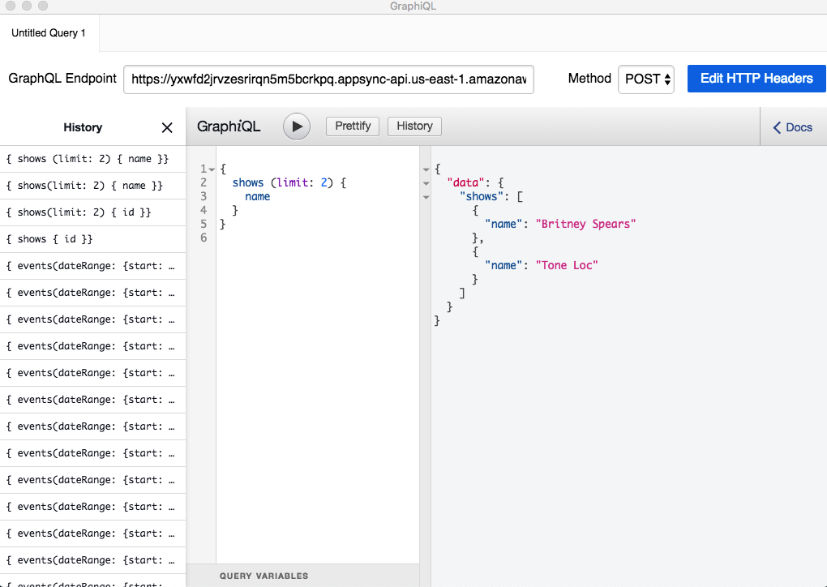
DEVELOPMENT TOOLS. GRAPHIQL
https://electronjs.org/apps/graphiql

Slide 14
DEVELOPMENT TOOLS. FIDDLER
Request proxying
Traffic recording (save log with whole requests/responses data)
Composing HTTP requests (headers, auth, data)
Performance, security testing
Customizable free tool
https://www.telerik.com/fiddler

Slide 15
INSTALL AND DEPLOY. NVM
Node version manager
CLI
https://github.com/creationix/nvm
NVM

Slide 16
INSTALL AND DEPLOY. DOCKER
Build Once & Run Anywhere
Safe runtime environment for app
No missing dependencies
Automate testing, integration, packaging
https://www.docker.com/

Slide 17
DEMONIZING THE APP. PM2
Process manager
Clustering
Monitoring
Logging
https://github.com/Unitech/pm2
Notes:
PM2 is a production process manager for Node.js applications, that has a built-in load balancer. PM2 allows you to keep applications alive forever and reload them without downtime, and will facilitate common system admin tasks. PM2 also enables you to manage application logging, monitoring, and clustering.

Slide 18
DEMONIZING THE APP. FOREVER
Minimalistic and simple
https://github.com/foreverjs/forever
Notes:
Forever is a simple command-line interface tool for ensuring that a given script runs continuously (forever). Forever’s simple interface makes it ideal for running smaller deployments of Node.js apps and scripts.

Slide 19
LOGGING. WINSTON
Streams
Transport
Formatting
Levels
https://github.com/winstonjs/winston
Notes:
Winston is designed to be a simple and universal logging library.
Streams: Winston uses Node.js streams, which is a performant way of chunking up data processing—for instance, data manipulation on large amounts of data. Streams break tasks down into small, manageable chunks so it’s easier for your Node.js system to handle. Curious why? Read up on streams and the event loop.
Transports: Logs need to go somewhere. By default, console.log goes to your standard output file. However, you may also want to stream your logs to a central location, or store them in a database for querying later. Winston allows you to do that easily with a concept called transports. What’s also nice about using Winston is that you can have as many transports as you like.
Formatting: Your regular console.log, by default, only deals in strings. We’ll come back to why this is problematic later. But Winston has some advanced features for formatting log code before stashing it away. For example, Winston offers JSON formatting, coloring log output, and the ability to fiddle with formats before they’re posted off to your end log locations.
Levels: Winston adds another interesting layer, which is log levels. Log levels are metadata for logs. In plain English, this translates to data about data. Log levels tell you the severity, ranging from as severe as a system outage to as small as a deprecated function. The reason for having log levels in the first place is so you can quickly see which logs need attention. Log levels also allow you to configure environments to log the correct amount of data, with amounts of detail.
https://stackify.com/winston-logging-tutorial/

Slide 20
LOGGING. BUNYAN
JSON logging library
https://github.com/trentm/node-bunyan

Slide 21
deploy AND tools BY Siarhei Melnik
NODE.JS GLOBAL

